Slide 1
Flipping (the lab) with Video
A short description of how I use videos to help students prepare for lab.
Cathy Welder, Dartmouth College
Active Learning in Organic Chemistry Workshop

Slide 2
Outline
By the end of this presentation, you will be able to describe how and why I create videos for my lab courses using
Video camera demonstrations.
Doceri annotations of PowerPoint.

Slide 3
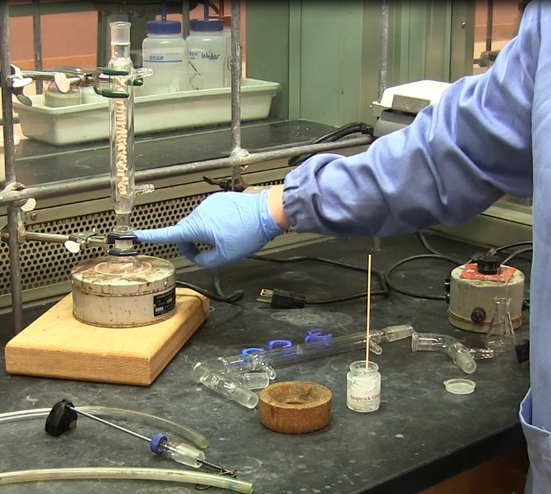
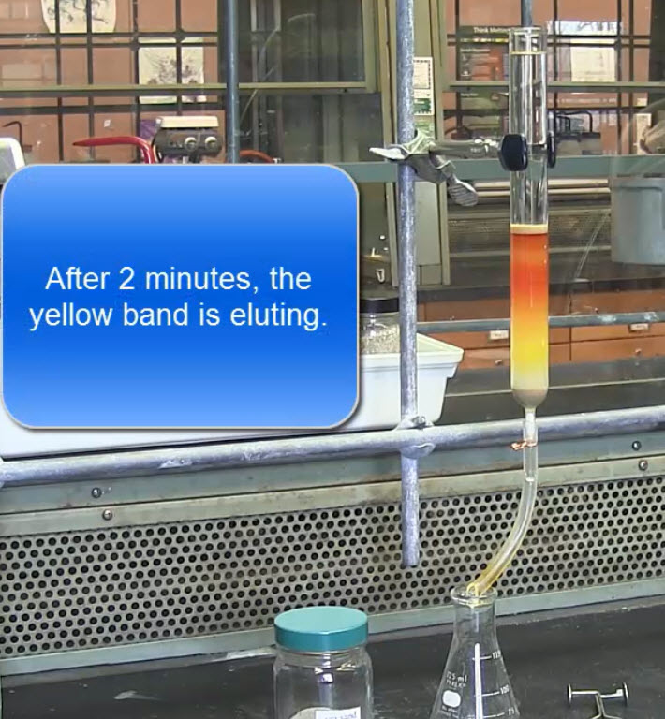
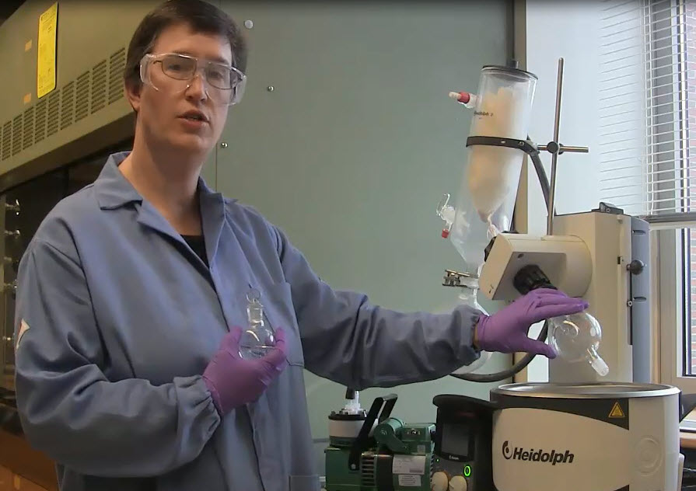
Methods of Creating Videos: Video Camera
Video camera and tripod were obtained from the library’s media center to record instrument demonstrations and experiment setups.

Slide 4
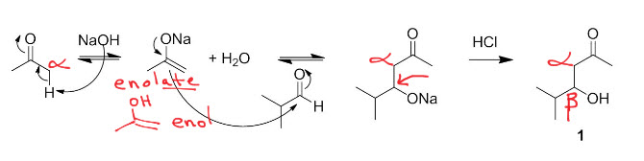
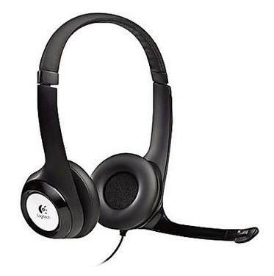
Methods of Creating Videos: Doceri with Camtasia and PowerPoint
PowerPoint presentations were annotated with Doceri and recorded via screen capture with Camtasia.

Slide 5
Summary
Recording demonstrations in the lab with a video camera resulted in more student self-sufficiency and confidence during lab.
Recording PowerPoint prelab lectures with Doceri and Camtasia allowed students to
use the entire lab period for longer experiments.
arrive at staggered start times.

