Slide 1
Livescribe pens
A Short Description of How Livescribe Pens Are Used in the Chemistry Department at Dartmouth College.
Cathy Welder, Dartmouth College
cCWCS – Active Learning in Organic Chemistry
Washington, D.C., June 24, 2015

Slide 2
What Can You Do with the Pen?
Record audio only.
Record writing only.
Record audio and writing.
Record audio then add written material during playback. (Syncs audio to paper.)
Files can be transferred to your computer and then shared.
Livescribe 3 displays written material on screen as you write. (Android and iOS devices)

Slide 3
How do we use the pens?
Lecture Material
Flipped classroom
Remedial or tutorial topics
Answer Keys
Quizzes
Exams
Problem sets
Data Sharing and Electronic Notebooks in Teaching Labs
Research Notebooks

Slide 4
How might we use the pens going forward?
Recorded Office Hours
Project written material (Livescribe 3)
Reflector app
Apple TV
Direct video cable to iOS or Android device

Slide 5
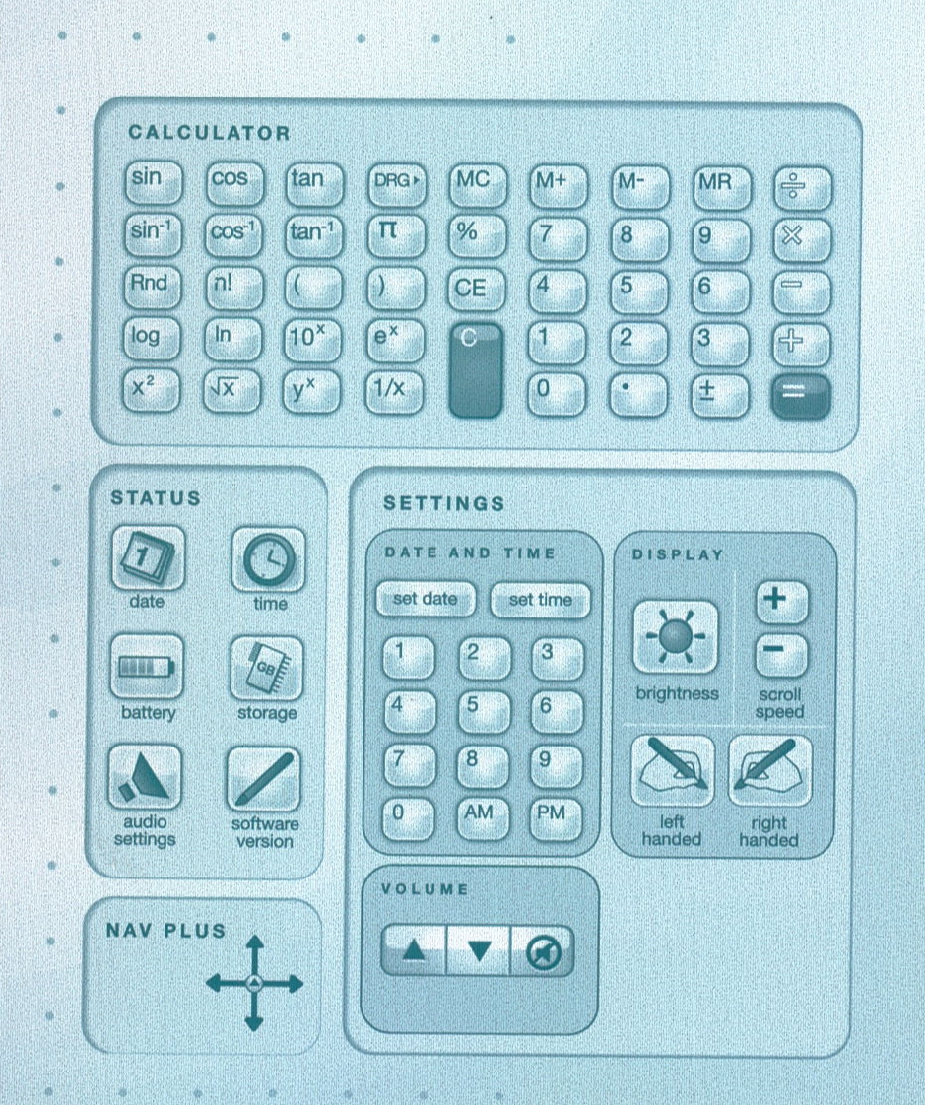
Introduction to the Pen

Slide 6
Introduction to the Pen
Controls are found at the bottom of each page.
Demonstration
Record
Transfer to computer (Use Echo Desktop.)
Create pencast (Select pages and Share.)
Play in browser (Chrome, Safari, or Internet Explorer)

Slide 7
Pros
Notes are converted to a digital format.
Text is searchable, even with poor handwriting!
Pencasts can be sent to Evernote, Facebook, OneNote, mobile devices, and your computer.
Echo pens work with PC or Mac. Livescribe 3 works with Apple or Android devices.
Livescribe 3 uses microphone and storage capacity of iOS or Android devices
Comes with 500 MB free online storage.

Slide 8
Cons
Pen is somewhat bulky/heavy.
You cannot write in color.
Ink cartridges are small. (5 refills for $7)
You cannot edit the audio. (You can pause.)
Difficult to print “printable notepads.” (Use the Postscript driver!)
Read app reviews before purchasing.

Slide 9
Helpful Hints
Write before you speak.
Be careful not to cover camera with finger when writing.
Bookmarks put a star on top of the last thing you wrote, partially covering it.
Livescribe PDF files are now played through a browser. (Livescribe Desktop played through Adobe Reader.)

Slide 10
Helpful Hints
1 GB gives ~ 100 hours of recording time.
Permanently remove data from the pen by archiving the notebook.
3-D Recording Premium Headset ($20) records better sound for Echo pens.

Slide 11
Costs (Livescribe.com)
Item | Cost
Echo Pen | $120 (2 GB)
Sky wifi Pen | discontinued
Livescribe 3 | $150
Ink Cartridges | 5 for $7
Headset | $20
3-subject notebook (150 sheets) | $9
(Save $20 with referral.)

