Slide 1
Transformation of the Traditional Organic Chemistry Lecture Sequence into a Hybrid of Face to Face Peer Learning and Online Lecture
Vincent Maloney

Slide 2
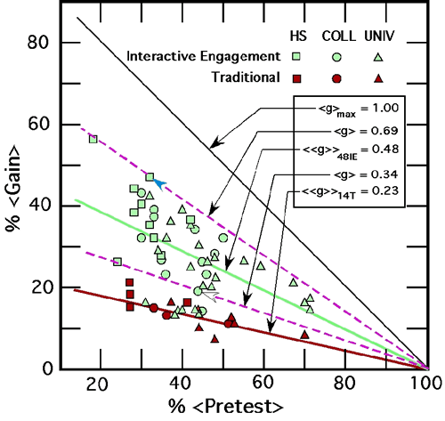
Why Change Everything?
CELT Fall Teaching Conference 2007, Todd Zakrajsek
Hake, R. R. American Journal of Physics, 66, 1998, 64-74

Slide 3
Why Change Everything?
L. Nilson, Teaching at Its Best p. 107, Traditional Lecture
Bloom’s Taxonomy
Knowledge
Comprehension
Application
Analysis
Synthesis
Evaluation
CAT’s, JiTT, Peer to peer problem solving, POGIL address more learning outcomes, all remaining

Slide 4
Some Further References
Smith, K. A., Sheppard, S. R., Johnson, D. W., Johnson, R.T Journal of Engineering Education, 94, No. 1 2005, 87-101.
Freeman, S., Eddy, S. L., McDonough, M., Smith, M. K., Okornoafor, N., Jordt, H., Wenderoth, M. P. PNAS www.pnas.org/cgi/doi/10.1073/pnas.1319030111
Nelson, C. E. Want Brighter, Harder Working Students? Change Pedagogies! Cooperative Learning in Higher Education, 2010, 119-140.
Nelson, C. E. in Evolution Challenges: Integrating Research and practice in Teaching and Learning about Evolution Rosengren, K. S.; Brem, S.; Evans, E. M.; Sinatra, G. M. Oxford Scholarship Online, 2012 DOI:10.1093/acprof:oso/9780199730421.001.0001

Slide 5
MOOCs
Massive Open Online Courses
Unprecented competition
Can university professors be replaced? Should courses be taught a different way?

Slide 6
Recorded Lectures
Around for a long time
What’s different
Much easier to access and watch anywhere
Maybe courses should be done differently

Slide 7
Other Benefits of Active Learning
Retention
In specific class
At university
Graduation rates
Active learning
Interactions that build relationships
Students and professors
Others students

Slide 8
References
Smith, K. A., Sheppard, S. R., Johnson, D. W., Johnson, R.T Journal of Engineering Education, 94, No. 1 2005, 87-101.
Freeman, S., Eddy, Eddy, S. L., McDonough, M., Smith, M. K., Okornoafor, N., Jordt, H., Wenderoth, M. P. PNAS www.pnas.org/cgi/doi/10.1073/pnas.1319030111

Slide 9
Traditional Lecture
Students read text before lecture (maybe)
Lecture given in traditional manner
After class, students work on assignments
May work together
May ask instructor questions
Problems in understanding not recognized until homework turned in or quiz/exam

Slide 10
Organic Chemistry IPFW
Traditional lecture plus
Clickers questions
~ 3 per class with peer to peer problem solving
Review sessions
2 x week
Peer to peer problem solving
~40% of class attended
Arrangements for those who could not attend
Lectures recorded on Tegrity for subsequent viewing
Courses partially flipped

Slide 11
Flipping IPFW Organic Chemistry
Record lectures < 20 min.
Lecture length based on topic
1.5 – 20 min.
Chunking (Nilson)
295 lectures recorded year
130 fall semester
≈17 h, ≈ 20.5 classes!
165 spring semester
≈17 h, ≈20.5 classes!

Slide 12
Flipping IPFW Organic Chemistry
Students watch lectures before class
Students complete online homework assignment in Blackboard
162 questions in fall
98 questions in spring

Slide 13
Flipping IPFW Organic Chemistry
Face to Face Class
Nearly entire class devoted to peer to peer problem solving
98 students fall semester
88 students spring semester
Ask questions of increasing complexity, scaffolding
10 – 12 questions per class
Very little review in class

Slide 14
Flipping IPFW Organic Chemistry
Review session and some traditional homework from text now in class
Everyone benefits from “review sessions”
Should be time shift for student
Exam/quiz schedule kept the same

Slide 15
Summary of Results
Good news
Students like it
Bad news
No improvement in grades
Did no harm!
1st attempt
Foundation from which to improve

Slide 16
Student Survey
Given last week both semesters
IRB approval pending
22 questions
Likert Scale
1 strongly disagree to 5 strongly agree

Slide 17
Student Survey
I prefer watching the online lectures because it allows more time to work on difficult problems and concepts in class.
I believe that I learned material better with the current format than I would have if the course had been presented in the traditional format.

Slide 18
Student Survey
I understand the material better when I can work on problems with other students during class.
I got to know more classmates in this class than I would have in a traditional format.
The current format should be continued for organic chemistry.

Slide 19
Conclusions
Solid majority believes they are learning material better
Larger majority wanted to continue this method for 2nd semester
If meeting and building relationships helps with retention and obtaining a degree, then there is evidence that “flipping the classroom” does that.

Slide 20
Assessment and Grades
Assessment
Pre- and post-test scores not available
Compared grades to 2011-2012 and 2012-2013 organic classes.
Obviously limited, many variables, exams and quizzes not the same
Perhaps broad changes can be observed
Data complicated by drop/make-up policy and changes to accommodate flip
End of spring semester: National ACS 2004 Organic Chemistry Exam

Slide 21
Assessment and Grades
Grading Fall
Year | Quizzes | Nomenclature Quiz | Exams | Final Exam | Clicker | Homework | Total
2013 | 100 | 0 | 200 | 150 | 50 | 50 | 550
2012 | 100 | 25 | 200 | 150 | 25 | 50 | 550
2011 | 100 | 25 | 200 | 150 | 25 | 50 | 550

Slide 22
Assessment and Grades
Grading Spring
Year | Quizzes | Nomenclature Quiz | Exams | Final Exam | Clicker | Homework | Total
2014 | 100 | 0 | 200 | 200 | 50 | 50 | 600
2013 | 100 | 25 | 200 | 200 | 25 | 50 | 600
2012 | 100 | 25 | 200 | 200 | 25 | 50 | 600

Slide 23
Assessment and Grades Overall Results
Over the entire, year the performance of the “flipped class” was comparable to the previous two “traditional” classes including the ACS exam
Lower withdrawal rate in fall may indicate flipped classes may favor persistence, but not observed in spring
Whatever effects the complete course flip had, they are small in comparison to other factors leading to variability in scores.

Slide 24
Assessment and Grades Overall Results
Effect of active learning diminishes with > 50 students
Course already extensively flipped
Improve engaging all students
Use more question scaffolding
Better pacing

Slide 25
Conclusions
Majority of students prefer flipped class
Student did meet more fellow students
Effect on retention and graduation?
Comparable grades
“Flip” did no harm, students like it, and room to improve learning!

Slide 26
Thanks!
Center for Enhancement of Learning and Teaching
Gail Rathbun
Ludwika Goodson
Stephanie Stephenson
ITS
Mike Phillips

