Slide 1
Active Learning in Organic Chemistry 2023 Workshop
CoLTs and LATs
Assignments on the second slide
Complete the information on the slide with your name

Slide 2
Team Assignments
 |  | Topic Teams
 |  | 1- Aldehydes and Ketones | 2-Alkenes | 3-Aromatic Substitutions | 4-Carb Acid Derivatives | 5-Spectroscopy | 6-Stereochemistry
Expert Teams | CoLT 16 Struct Prblm Solv
 | CoLT 25 Round Table
 | LAT 2 Bkgd Knowl Probe
 | LAT 17 TAPPs
 | LAT 21 Knowledge Grid

Slide 3
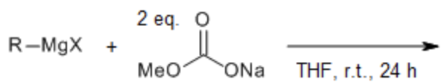
Aldehydes and ketones - Structured Problem Solving
Description of method:
Instructor: Develop a complex problem requiring sophisticated problem-solving techniques. Divide the students into groups and assign the problem. Have teams report on what is known, what needs to be known, and how to find the absent information or knowledge.
Students: Work in groups following a structured format. Using this technique, students can learn to identify, analyze, and solve problems in an organized manner by dividing problem-solving processes into manageable phases. The group must reach a consensus on a solution and explain the solution and the strategy used to resolve the issue.
Strength: This technique can build problem-solving skills and trust before employing more complex methods. The groups can construct a response that identifies the components of the problem-solving procedure.
Concern: The activity has a time constraint that may challenge students with accommodation. Unprepared or underperforming students may depend on others to do the work.
Implementation plan:
Topic: Extension of the Grignard addition to aldehydes and ketones
Learning objective: Draw the mechanism (without Mg complexation) for the reaction between a Grignard reagent and a sodium methyl carbonate. Predict the product of the reaction.
Instructions: Using the basic principles of reaction mechanisms and what we learned about the addition of Grignard to ald/ket, determine the product formed in the following reaction. Use arrow pushing to support your answer.
Expectations: Challenge that the specific reaction was not covered in class. More applied students will apply the basic principles of reaction mechanisms to figure out the problem. Use CAT 20 for this problem.
Source: DOI:10.1021/acs.orglett.9b00773 Org.Lett.2019,21,3882−3885

Slide 4
Aldehydes and ketones - Structured Problem Solving
In class we discussed the addition of Grignard to aldehydes and ketones. Using the same principles, use the following reaction to address these statements/questions.
Identify the nucleophile and the electrophile.
What is the purpose/role of THF?
Does the sodium methyl carbonate have a good leaving group? If yes, what is it?
Why do we need two equivalents of the sodium methyl carbonate per Grignard reagent equivalent?
Draw the mechanism (without Mg complexation) for the reaction between a Grignard reagent and the sodium methyl carbonate.
Predict the product of the reaction.
How is this reaction similar to the Grignard addition discussed in class? How is this reaction different?

Slide 5
Aldehydes and ketones - Structured Problem Solving
Description of method: Students in groups are given a large complex problem and asked to solve it by a series of steps. All members have to agree as well as be able to explain both the solution and the route they used to arrive at the solution. The full set of steps (although it seems like not all problems are amenable to all of these steps) are 1) identify the problem, 2) generate possible solutions, 3) evaluate and test possible solutions, 4) decide on a mutually acceptable solution, 5) implement the solution, and 6) evaluate the solution.
Implementation plan: Well… if I really wanted them to come up with a solution, then implement the solution, then evaluate the success of it, that really seems to lend itself to a laboratory assignment (sorry, I know some of you are lecture-only).
Task: find a “best” synthesis of 3-hexanol (the odor of pineapples). Step one is possibly done for them, although perhaps I could make them do even that task if I asked them to look up what compound was responsible for pineapple’s smell. Step 2 is designing on paper several solutions. Step 3 would be working with me to determine which syntheses are feasible given our supplies and equipment. Step 4 would be deciding on which synthesis/syntheses they want to implement in lab. Step 5 would be to do the syntheses (incl. purification, characterization, etc.). Step 6 would be to determine the yield (comparing it to other synthetic methods if they do more than one), and if I am feeling especially ambitious, asking them to factor in the cost of the reagents to determine which one is the cheapest.

Slide 6
Aldehydes and ketones - Round Table
Description of method: The instructor provides a prompt to groups of four students. Each student will answer the prompt individually, one at a time writing a few words or phrases on a piece of paper, telling the group what they wrote, then passing to the next student. Each student subsequently contributes new answers to the prompt, reflecting on the previous students’ responses. The responses should be written quickly so that other students don’t have to spend too much time waiting.
This method encourages all students to contribute, while limiting how much the more verbose students can contribute, so they don’t dominate the exercise. Participation becomes more equitable.
Should not be used for questions requiring more complex thinking because it is meant to be faster paced so other students don’t get bored. It doesn’t leave room for much discussion due to time constraints.
One of the examples used this method to assess the muddiest points surrounding a particular topic that students had found confusing in previous semesters. In the round table, students put check marks next to responses that they also struggled with. The professors used the responses to help organize a review session before moving on.
Implementation plan: My first instinct was to use this method for multistep synthesis or reviewing reactions by doing subsequent transformations building off of an aldehyde or ketone starting molecule, but this method is not advised to be used for more complex thinking for time constraint reasons. It could be used for review of reactions, by having students propose one transformation each to a starting molecule using new reactions from the chapter, but this may still be time-consuming.
While this could be useful in assessing muddiest point, like in the example, it is also useful for brainstorming, which could be utilized in a prompt where students have to troubleshoot a reaction that did not work or to predict reactivity based on prior knowledge.
Prompt when introducing aldehydes and ketones: Consider the structure and properties of aldehydes and ketones, how do you expect these functional groups to behave in reactions?
Anticipated responses: carbon electron poor (electrophile), oxygen electron rich (lewis base), pi-bond will break in reactions, will form racemic addition products, aldehydes more reactive/less stable
Each group can then provide one of their answers and the instructor can add anything missing and lead into reactions.

Slide 7
Aldehydes and ketones - Background Knowledge Probe
Description of method:
The background knowledge probe is an ungraded survey of 5-10 questions geared towards investigating the level and understanding of students pre-existing knowledge.
Each question on the survey also has a confidence rating associated with it, which allows you (after analyzing the data) to determine if there are misconceptions (incorrect responses with high confidence rating) or if your students have low confidence in the material (correct response with low confidence rating.
Implementation plan:
Topic: Assessing important pre-existing knowledge needed to be successful in understanding the reactions between A/K and alcohols, including equilibrium.

Slide 8
Aldehydes and ketones - Background Knowledge Probe
This is an ungraded assignment aimed at assessing what you already know. I will use the results to plan our class sessions. Answer the questions as accurately as possible by placing an “X” in the appropriate column to demonstrate whether you think each statement is true or false, then circle the number in the last column that best reflects your confidence in the correctness of your answer (1 = low confidence; 5 = high confidence).
 | True | False | Confidence Rating
In an aldehyde the electrophilic site is the oxygen atom of the C=O. |  |  | 1 2 3 4 5
Catalysts participate in a reaction but are not consumed in the reaction. |  |  | 1 2 3 4 5
Catalysts speed up a reaction by raising the activation barrier of the rate limiting step. |  |  | 1 2 3 4 5
Q’s on Le Chatlier’s Principle |  |  | 1 2 3 4 5
Topic: Assessing important pre-existing knowledge needed to be successful in understanding the reactions between A/K and alcohols, including equilibrium.

Slide 9
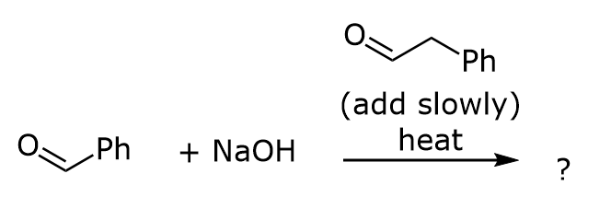
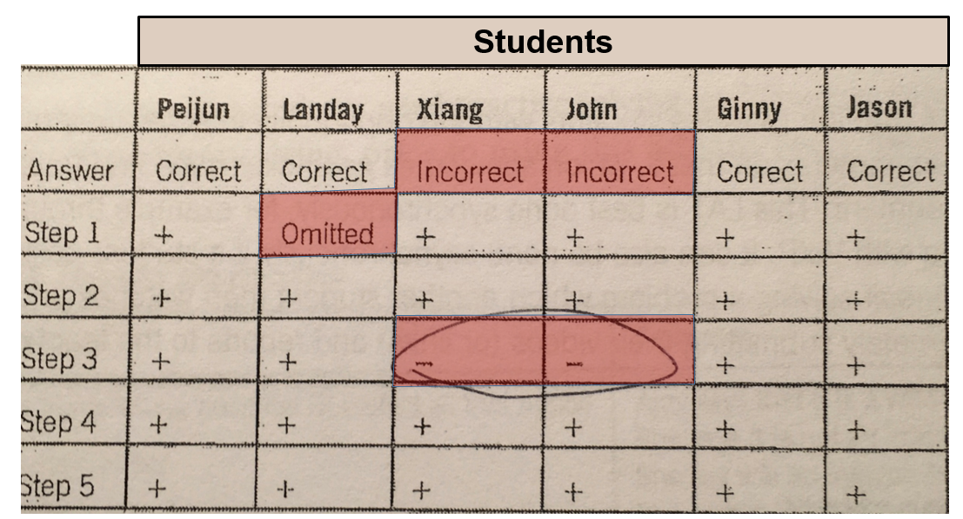
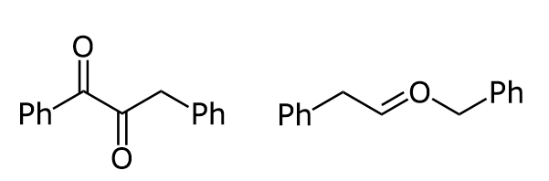
Aldehydes and ketones - TAPPs (Think-Aloud Problem-Solving Protocols)
Description of method:
Implementation plan:
Students work in pairs with 2 roles:
LO: Predict the products of crossed aldol reactions.
Example problem:
Student responses (incorrect):
I’m solving this problem while talking through my process for solving this problem (steps)
I’m recording your process (steps) that you use to solve the problem
Example: students worked on problems that were normally a huge stumbling block and caused students to drop the course. The instructor used the results to find the exact part of the process where they were stumbling (step 3).
Problem solver Listener
I’m reviewing the answer and the steps in the process.
Instructor
Strengths: 1) Help instructor to ID problem areas (major?)
2) Metacognition for students (minor?)
Weaknesses: students working in pairs; high workload to set up and analyze; student buy-in?

Slide 10
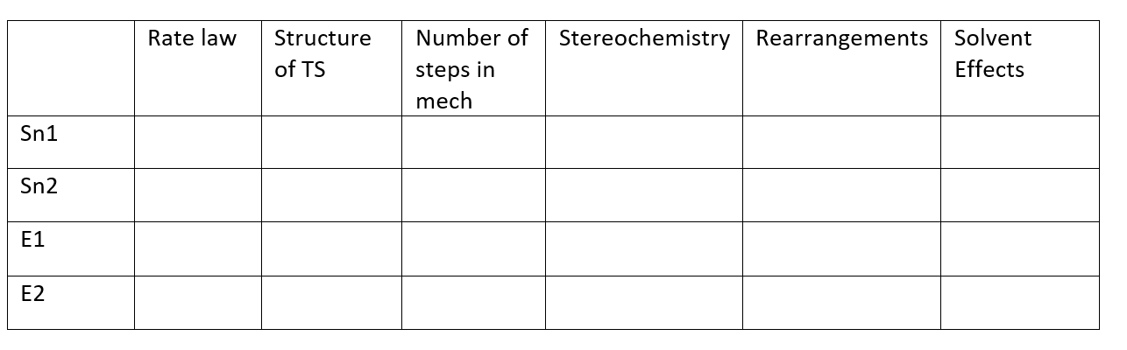
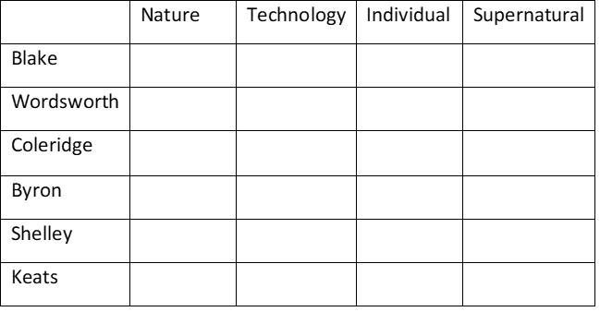
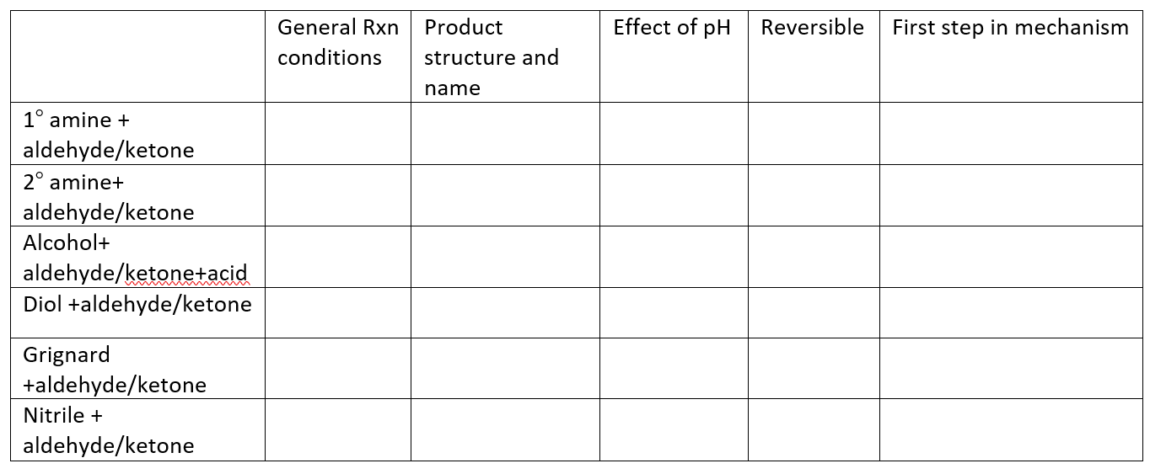
Aldehydes and ketones - Knowledge Grid
Description of method: Provide a grid like the one below and have students fill within the grid their understanding of the relations between the topics you select on the axes. You can grade based on a 1/0 system where 1 would be if they have listed a correct statement about the relations. This also can be used as a pre-test/post-test where the pre-test informs you of their understanding before the content is covered.
Implementation plan: I think the challenging part about this activity is devising appropriate sections. I naturally gravitate to Sn1, Sn2, E1, E2 reactions (shown below). Although since I’m in the aldehyde and ketone group I took a stab at that as well…Although I don’t like the aldehyde/ketone example as much.

Slide 11


Alkenes - Structured Problem Solving
Description of method:
Students will be organized into teams and given an alkene reaction problem to solve. Utilizing the structured problem solving strategy of identifying the problem (A), generating possible solutions (B), evaluating and testing various solutions (C), agreeing on a solution (D), implementing (E) and evaluating the solution (F) each team will be guided through the problem solving process through a series of questions and will be expected to come up with an answer. Furthermore, teams will be sharing their solutions to the rest of the class.
Implementation plan:
Sample Problem: Draw the major product of the following reaction:
1. What is this reaction called? 2. What functional group will the product of this reaction have?
Draw out possible products with the functional group chosen in A.
1. What mechanism do you think this reaction will undergo? 2. With your chosen mechanism, do you think you’ll have more than one product? 3. Draw out this mechanism.
Do you think your chosen mechanism in C will help you in answering this problem?
What is the major product based on your answer in C?
What will be the major product of the following molecule below using the same reaction conditions?

Slide 12
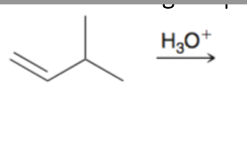
Alkenes - Round Table
Description of method:
Meant to be for review and quick.
Instructor: Design a prompt. Put students into groups of four and students do not discuss the answer. One student would start answering the question, and the next student will build on the first students’ answers and keep going until all four students are done.
Implementation plan:
Predict the products formed for this reaction. (Hint: there are two products)
Check to ensure the products predicted in Q1 is correct. If not, revise. Based on the products, identify the rearranged and non rearranged product?
Draw out the mechanism(s) for the products you wrote down for #1.

Slide 13
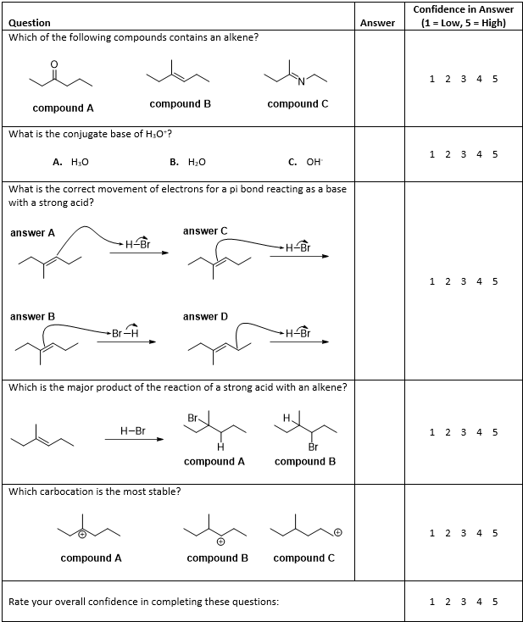
Alkenes -
Background Knowledge Probe
Description of method:
Students will be asked to complete a short quiz covering concepts important to alkene mechanisms and reactions. The responses will be collected and the confidence levels organized in a table.
Implementation plan:
Student confidence in functional group recognition, acid-base reactions, mechanism arrows, reaction intermediates, and predicting the major products of a reaction are evaluated.

Slide 14
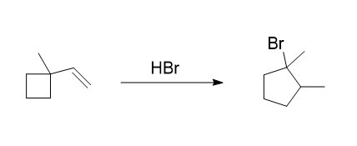
Alkenes - TAPPs
Description of method:
Students will be assigned into pairs. The pairs will be chosen based on various factors to ensure that people are working with different people throughout the semester. High achievers with low achievers, gender diversity, etc. will be ensured.
Implementation plan:
Students will be asked to draw a mechanism of the following reaction. Person A will describe the problem solving process while the Person B follows directions and records. The important part here is not just to get the mechanism of the reaction, but also to reinforce the process by which a complex mechanism like this is solved.

Slide 15
Alkenes - Knowledge Grid
Description of method:
A visual way to organize a large amount of information.
Draw connections
Summarize
~1-3 lectures of material?
Implementation plan:
Purposely include some overlapping categories
Students could draw structures in the cells
Work in groups
Come together at the end of the activity and fill in a grid on the board, explaining each cell
 | Regioselectivity | Markovnikov’s Rule | Intermediate (draw) | Rearrangement possible? | Stereochemistry (syn/anti/…) | Synthetic utility
Hydration (acid)
Oxymercuration
Hydroboration

Slide 16
Aromatic Substitutions- Structured Problem Solving
Structured problem solving involves giving a complex problem to a team of students with a few prompts especially:
What do you know?
What do you need to know?
Where can you find out?
Giving the students the steps to problem solving could be helpful:
Dewey six-step problem-solving technique:
a) Identify the problem, b) Generate possible solutions (brain storming), c) Evaluate and test possible solutions, d) Decide on a mutually acceptable solution, e) Implement the solution, f) Evaluate the solution
Explain what the instructor does
Determines a complex problem based on content in course. Provides students a roadmap to approaching the problem. Places students in teams (at least one strong student)
• Explain what the students do
Need to determine problem and how to solve it with fairly minimal guidance. Present their solutions at various points to the instructor to determine if they are on the right track.

Slide 17
Aromatic Substitutions- Structured Problem Solving
Describe a strength of this method
Students need to discover the solution to the problem using resources outside of the classroom and may have problems assigned to them with real-world implications, raising the significance of the activity to them.
• Describe a concern you would have implementing this method
Many good problems probably mean the instructor would not know the outcome/solution. In chemistry, it may include ordering supplies or require equipment difficult to access/operate. Instructor should allow students to struggle through the process at times, which could be frustrating. This could take a lot of time, so the problem needs to be complex enough to be interesting, but limited enough that it can be completed in the time allotted.
Example
Perhaps exploring aromatic based pollutants that are important locally, like PCBs or dioxin.
in environmental contexts. Why were they used? Relate to human health. How do we determine their presence and test for them in soil?
• Describe the topic and learning objective
-implication of aromatic stability. Relate stability to persistence in the environment. Describe human health effects. Application of laboratory techniques such as extraction and GC/MS analysis.
• Describe the instructions / support students would receive

Slide 18
Aromatic Subst - Round Table
Description of method:
In the round table, students work in groups (usually of 4 though round tables going through a whole class are possible) and take turns writing down thoughts, ideas, or answers to prompts provided by the instructor. The prompts can be targeted more towards problem-solving, brainstorming, or identifying muddiest point. For brainstorming, it is specified that ideas are not judged, questioned or praised to encourage the highest level of creativity. Because this method is a written method, it can help students participate that might have difficulty verbally expressing their ideas or questions and ensures that everyone in a group participates. Because of the possible time involved with waiting for students to write their contributions, this method is not recommended for complex, high-level thinking.
Thought process and reflections:
My first thought for this was to do a round table synthesis question because I think it could be highly interesting to see students course corrections as they work off of the previous steps but I think this could also lead to some frustrations among students which is counterproductive. I do think that this method could be highly useful for starting synthesis questions which is consistently something that students struggle with. One of the most common questions/concerns is not knowing where/how to start when approaching a synthesis problem. So doing a round table where everyone just writes down something about the synthesis process, some type of idea or even just jotting down how to form a functional group included would help students see some of the different ways to tackle synthesis problems. I think this would show students that there are a lot of ways to solve problems and there are a diverse group of perspectives that are helpful in the process. So in this particular example I would likely focus on giving students a fairly complicated synthesis problem using EAS reactions and asking students to take turns writing down only one idea until everyone has contributed at least one. And then once they have completed it then they can work as a group on the whiteboard and start putting together their synthesis.

Slide 19
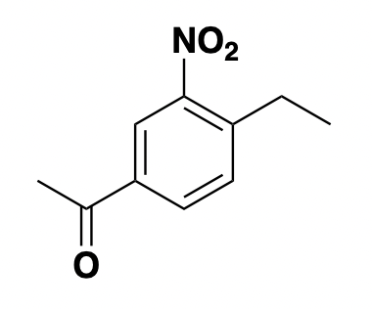
Aromatic Subst - Round Table
Implementation plan:
This implementation is focusing on getting students started on a synthesis problem where many students struggle to know how to start so this focuses on students just identifying any preliminary thoughts that might help. This could include what kinds of bonds need to form, what functional groups exist, how they might be formed, etc. After they complete the brainstorm, have them start working on the actual synthesis.
(10 minutes) For the product below, take turns in your group to brainstorm possible ways to start proposing a synthesis for this compound from benzene. This is not a verbal exercise and instead each group member will have 30 seconds at the board to jot down their ideas. Each person should contribute an idea before anyone goes again. Please note, all ideas are welcome, this is not the time to question, judge, or praise ideas, this will come later!

Slide 20
Aromatic Subst - Round Table
Other Ideas Developed in Faculty Group:
Use a round table during review sessions by having students take turns filling in concept maps or a series of predict the product questions. Might even be able to have multiple concept maps in a single group that get shared around to encourage students to switch between different topics and could be useful for a final review. Completed concept maps could be posted after class for students to check their group’s answers.
Could do a mash-up of a round table with knowledge grid and have students take turns filling in the knowledge grid and maybe put a time limit to keep things moving.

Slide 21
Aromatic Subst - Background Knowledge Probe
Description of method:
The background knowledge probe is a short survey of 5-10 questions on fundamentals of the topic (and also pre-requisite knowledge) that you give students before starting the topic. Students should know the answer to at least one of the questions.
Students are also asked to rank their confidence level for each question (and/or the survey overall). You can then identify knowledge gaps, misconceptions, or where students need more of a challenge.
Can be short answer, TF, MC, but needs to be able to be assessed quickly.
Implementation plan:
Come up with the fundamental question from pre-req. Knowledge that students should already know the answer to.
ex. What is an electrophile?
Come up with 5-10 additional fundamental questions, some can be unfamiliar (look to LO’s). Try to avoid jargon.
Assemble into a survey, adding confidence ranking
Evaluate responses on an individual and/or average basis. Note high confidence wrong answers (misconceptions) and low confidence right answers (need to build confidence)
Plan class activities accordingly (maybe students don’t have as much background as you thought, or maybe you don’t need to spend as much time on a particular topic.)

Slide 22
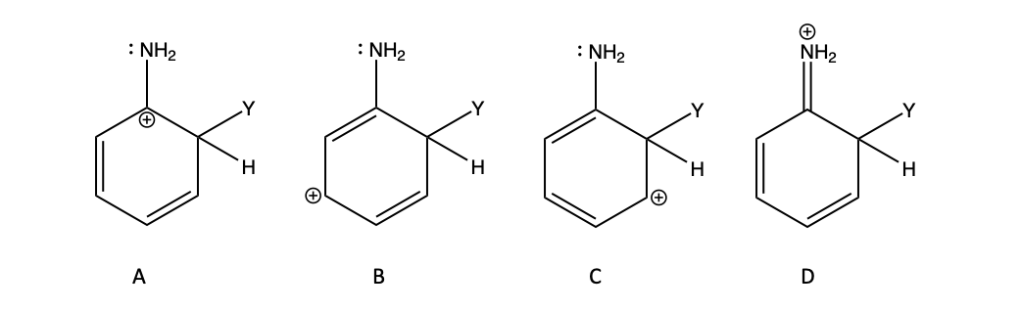
Aromatic Subst - Background Knowledge Probe
Background Knowledge Probe for EAS:
What is an electrophile?
  A chemical species that forms bonds by accepting an electron pair
  A chemical species that forms bonds by donating an electron pair
Rank your confidence on the previous question (circle) 1 (least confidence) 2 3 4 5 (most confidence)
What concepts are important to consider when evaluating the stability of a carbocation? (open-ended)
Rank your confidence on the previous question (circle) 1 (least confidence) 2 3 4 5 (most confidence)
T/F: A more electronegative atom can pull electron density towards itself from a less electronegative atom through a sigma bond.
Rank your confidence on the previous question (circle) 1 (least confidence) 2 3 4 5 (most confidence)
Which of the following structures would you expect to be most stable (least sus?)?
Rank your confidence on the previous question (circle) 1 (least confidence) 2 3 4 5 (most confidence)
T/F: The structures in the previous question are aromatic.
Rank your confidence on the previous question (circle) 1 (least confidence) 2 3 4 5 (most confidence)
How are the species in the previous question related to each other?
  They are resonance structures of the same species
  They are tautomers of each other
  They are conjugates of each other
  It requires a chemical reaction to get from one of these to another
Rank your confidence on the previous question (circle) 1 (least confidence) 2 3 4 5 (most confidence)

Slide 23
Aromatic Subst - TAPPs
Description of method:
A pair of students receive a list of questions. One student speaks through the problem solving thought process and the other writes down as much as they can.
This method focuses on the problem solving process rather than the answer and challenges the speaker to articulate clearly in chemical language.
Implementation plan: Questions for the process.
1 - If the intermediate of the EAS mechanism is a carbocation would EWG or EDG groups stabilize the intermediate? Why?
2 - When substituted on the aromatic ring which (EWG or EDG) would lead to faster reaction times and why?
3 - Which stabilizing factor would have a larger impact on the intermediate of an EAS reaction at the para position; resonance or the inductive effect? Why?
4 - NAS has a carbanion intermediate. What would this change when considering questions 1-3?

Slide 24
Aromatic Substitution - Knowledge Grid
Introduction:
This activity is a sorting activity where students are given a list of concepts and are asked to arrange them into their appropriate categories.
• Prior to class, instructor choses a list of topics/ categories that organize the chapter/unit/course etc. The instructor creates a worksheet consisting of a grid, with the top columns and side rows displaying the superordinate concepts.
• Students are broken up into groups of 2-4 and receive a blank grid. • The students are given a mixed-up list of terms to organize into the grid. • The students fill in the cells by coming to a consensus on which items/terms belong where.
• Instructor can have the completed grids turned in and graded.
Implementation:
You can do this in many ways! You can do a very simple grid for a quick assessment as you start class (example: list subtituents and ask if they are EWG or EDG and o/p or m directors.
For a group you could list reactions and have them fill in a grid about specifics
substituent | EWG or EDG | director
-CH3
-NO2
-Cl

Slide 25
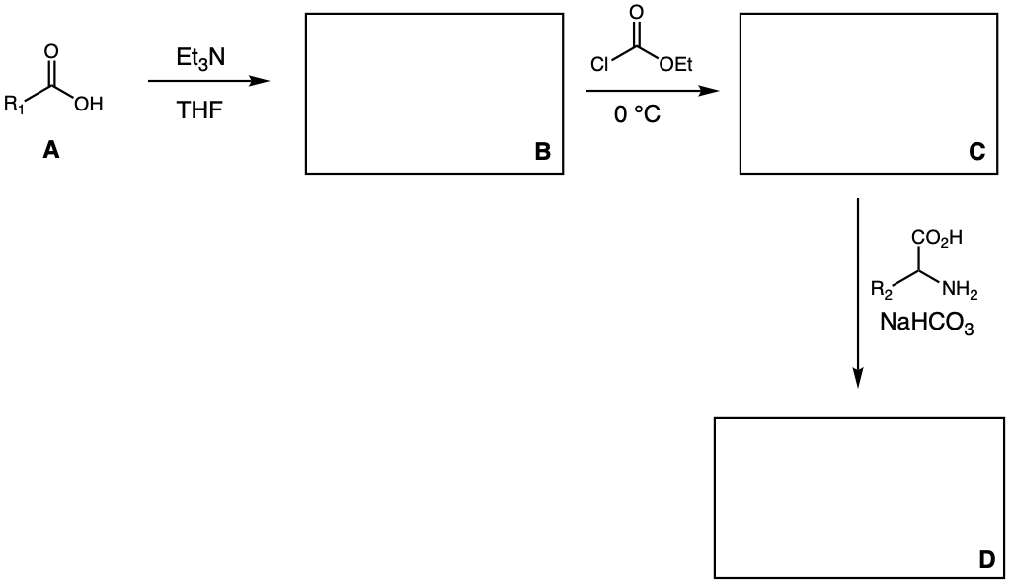
Carb Acid Der - Structured Problem Solving
Description of method:
Students are teamed up into groups of 4-5 then provided with a complex problem. Provide the students with a workflow/ questions to help guide them through this type of problem. Each team will work through the question and provide a solution, then report out to the class.
Implementation plan:
Challenging question: Draw the structures for unknowns B, C and D in the following reaction scheme.

Slide 26
Carb Acid Der - Structured Problem Solving
Students will be given a series of questions to guide them through this type of problem solving (predict the products). Take it one step at a time!
Identify the role of each reagent in the first step. Is each reagent an acid, base, nucleophile, electrophile?
What is the structure of unknown B? How does it change its reactivity compared to structure A?
In the second reaction (B to C), identify the role of each reagent.
Draw a reasonable arrow pushing mechanism for the reaction to help get to the structure for unknown C.
In the third reaction (C to D), identify the role of each reagent.
Draw a reasonable arrow pushing mechanism for the reaction to help get to the structure for unknown D.

Slide 27
Carb Acid Der - Round Table
Description of method:
Students take turns to respond to a given prompt, by writing words, phrases or sentences on a piece of paper before passing to another student who does the same.
This method allows students to write their ideas, as opposed to speaking, and gives them time to focus and think about their answers. It ensures participation of all students and sharing of different ideas.
Implementation plan:
Create a prompt that students can respond to with few words or sentences (i.e. Identify different factors that contribute to relative reactivity of different carboxylic acid derivatives). The prompt can be written on top of a sheet of paper.
Form groups of 4 students, and ask the students to respond.
Ask a student in the group to begin by writing their response as quickly as possible, read their response and circulate the paper clockwise. The next student will do the same.
Feedback from instructor (ideas):
have each group share 1 idea discuss as class
For bigger class size : have answer key available and self-assess
Notes:
can be implemented as summary ( reaction maps, summarize features of SN and E reactions, synthesis) or introduction to concepts

Slide 28
Carb Acid Der - Background Knowledge Probe
Description of method:
Students take a brief ungraded questionnaire to assess prior knowledge as well as their confidence in this knowledge.
This method helps to activate prior knowledge to improve assimilation of new information, and allows identification of students who may need additional help.
Implementation plan: Give BKP at end of class before beginning carboxylic acid chapter. Might also be effective to use at beginning of Organic I and II to evaluate retained prereq knowledge. 1 is not confident at all, 5 is highly confident. Might also use emojis in place of numbers.
Rank the following leaving groups from best to worst.
H:-, Cl-, H2N-, MeO-, AcO-, H3C-
Confidence (1-5)_______________
True or False: Carbonyl carbons are generally nucleophilic
Confidence (1-5)_______________
True or False: NaOMe is both a strong base and a strong nucleophile
Confidence (1-5)_______________
Provide a reagent that will convert an ester to the corresponding primary alcohol.
Confidence (1-5)_______________

Slide 29
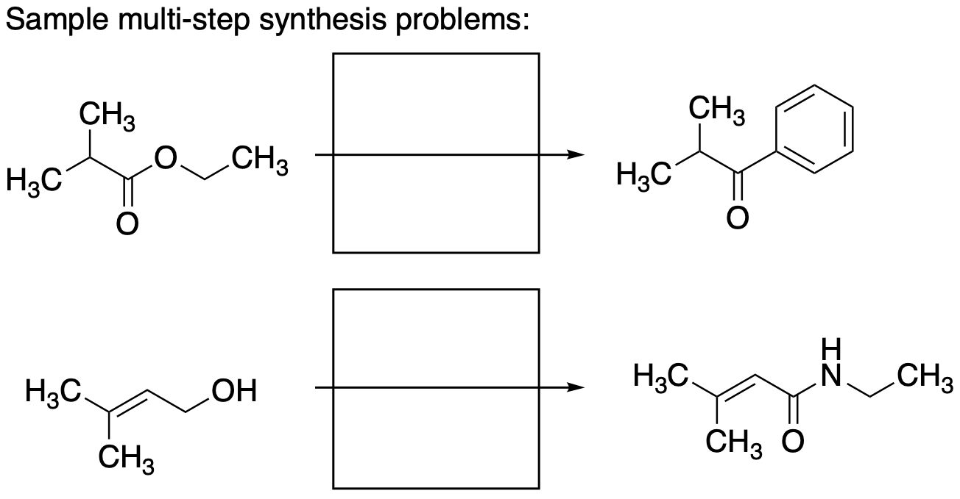
Carb Acid Der - TAPPs
Description of method:
The TAPP method involves pairs of students working on a set of problems. The students take turns working through individual problems while describing their reasoning aloud. The alternate student takes notes on the active student’s description, creating a record of the problem solving process and any missteps. This method encourages analysis of problem solving approaches, may expose students to alternative methods of problem solving, and helps students identify potential pitfalls. Instructors benefit from insight into the steps that students struggle with most. Potential challenges include creating problems that are likely to identify common challenges, including time to work through the problems and note the steps needed, and difficulties in the analysis of student-taken notes.
Implementation plan:
This activity is envisioned for in-class work for students that have already viewed pre-recorded lecture content and worked some more basic one-step transformation problems and are advancing to multi-step or synthesis/retrosynthesis problems. A set of multi-step transformation problems would be composed preparation of a carboxylic acid and manipulation of that acid into a downstream derivative. Students will work these problems alternating turns as “solver” and “recorder.” Whereas multi-step synthesis problems require additional planning and analysis of ordering steps, this activity will aide students in identifying how to analyze and choose viable synthetic routes, while reinforcing the application of the basic reagent combinations needed for manipulating carboxylic acid derivatives. Instructor may review responses to identify specific steps where many students struggle and address with directed content review.

Slide 30
Carb Acid Der - Knowledge Grid
Description of method:
Students fill in a grid with various items and subitems with the goal of connecting and integrating multiple topics from a given unit.
This method can build organizational skills and allow students to make connections between various topics in the field.
Implementation plan:
Prepare grids related to topic
Show students a model grid in a different field (e.g., biology or math)
Give students a grid and provide them with the items to enter into the grid. Have them work individually then compare and contrast answers within a group. At the end of class, report out to entire class.
Give students an open-ended grid and 1-2 examples of items that could be entered into the grid. Once again, have them work individually then compare and contrast answers within a group. At the end of class, report out to entire class.
Suggestion: Provide at beginning of chapter, then tell students we will fill it in as we go. Can be used for self-assessment. Eventually have students make their own knowledge grids!

Slide 31
Carb Acid Der - Knowledge Grid
Example Knowledge Grid for our topic: In the grid below, enter ‘strongest (one box per column), moderate, or weakest (one box per column)’.
 | Resonance stabilization of LG | Basicity of LG | Nature of LG | Resonance stabilization of acid deriv | Relative reactivity | Electrophilicity of C=O | IR wavenumber for C=O
Amides
Carboxylic acids
Acid chlorides
Acid anhydrides
Esters

Slide 32
Spectroscopy - Structured Problem Solving
Description of method:
Provide students with a complex problem to solve.
Provide students with a problem-identification procedure (What do you know/what are you given?, What do you need to find out? How or where can you find that?).
Provide the students a handout with a procedure/general steps (but not an overwhelming list with extreme detail).
Solve the problem yourself using the steps you provide your students to identify any problems or errors in the procedure.
All members of group must agree on solution and be able to explain the solution and the strategy used to solve the problem.
Implementation plan:
Provide students with spectral data of a single type or multiple types and ask them to solve the chemical structure.
Provide students with problem-solving strategy they should follow, such as first determine the degree of unsaturation, then make a list of key bonds present in the IR, etc.

Slide 33
Spectroscopy - Round Table
Description of method:
The instructor divides the class into groups of 4 students and gives them a prompt (spoken aloud or distributed on a handout).
One student in the group (to be selected by the instructor or the group) will respond to the prompt in writing by adding 1-2 points (words or short phrases) and then read their response(s) out loud.
The paper or handout containing the first student’s responses is passed clockwise to the next student and the process is repeated until each student has participated.
Implementation plan (two possible options):
Muddiest-Point Prompt: Ask students to provide 1-2 aspects of proton NMR spectroscopy that they do not fully understand. This can be related to the interpretation of the spectrum (e.g., a student may have trouble understanding how to correctly interpret splitting patterns) or be more conceptual (e.g., a student may have difficulty understanding why aryl and vinyl protons are more deshielded than acetylenic ones).
This prompt may later be used in a different collaborative exercice where students could respond to what others have written down and try to provide explanations.
I am not sure the following fits the description of the method as the students’ responses are not technically words or phrases: Provide students with a proton NMR spectrum and corresponding molecular formula. Ask them to deduce the structure of a piece or fragment of the molecule that gave the spectrum. The fragment may contain no more than three atoms that are not hydrogen, or it may be an arene with its correct substitution pattern (e.g., meta-disubstituted with 2 different substituents) if applicable. Each student should assign the hydrogen atoms in their fragment to the corresponding proton NMR signal by annotating them with the signal’s chemical shift.

Slide 34
Spectroscopy - Background Knowledge Probe
Description of method: This technique uses a ‘background knowledge probe’ to gain insight to students’ foundational knowledge relevant to a given topic. The probe is essentially a quiz with easy to assess questions that probe existing knowledge or understanding. Students are also asked to self-assess so that you can see if they are over-confident in their responses or under-confident in their abilities.
Implementation plan: 5-10 questions are developed that start with a fundamental most students are expected to understand and then questions build from there. If the topic is 1H NMR spectroscopy, students may be asked to identify symmetry in molecules. This identifies distinct H types. Similarly, students can identify distinct carbon groups in the manner they would have done for stereochemistry. A separate but related topic to 1H NMR, students are asked to identify electronegative atoms and pi systems so that they can relate to chemical shift. Students are asked to identify the number of H atoms on a given carbon (from line-angle structures) to determine both integration and coupling. Along with these questions, students are asked to self-assess their confidence on each question. In class, the quiz is announced. It is stated this won’t be graded, but is used to lay the groundwork for what we’ll be covering. After administering the quiz, look for common sources of confusion or students that exhibit over- or under-confidence. Consider sharing with students.

Slide 35
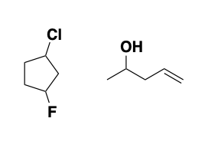
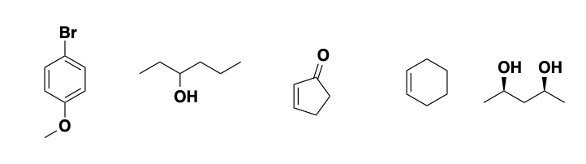
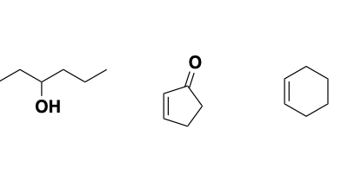
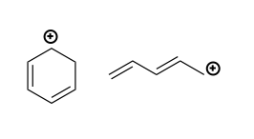
Spectroscopy - Background Knowledge Probe
Example:
Pick out the most electronegative atom in each of the following molecules.
Give the molecular formula for each of the following molecules.
Identify if there is a line of symmetry for each molecule. If there is a line of symmetry, draw it in.
Use resonance to show all electron rich carbon atoms in the following molecules.
Use resonance to show all electron poor carbon atoms in the following molecules.

Slide 36
Spectroscopy - Background Knowledge Probe
Description of method:
Before beginning a unit of new material, students are given an questionnaire assessing their knowledge related to that topic and of the prerequisite material for it. In addition to the factual questions, students are also asked their confidence in each answer and their overall confidence of the assessment. This helps to identify students who are unreasonably confident or who need a boost in confidence.
Implementation plan:
First, a series of questions (perhaps 6-10) need to be developed regarding the background knowledge students have relevant to learning organic spectroscopy. These questions would cover determining the molecular formula for a given organic structure along with calculating molecular weights and degrees of unsaturation. The ability to correctly identify functional groups would also be assessed.For each question, they will also be asked to rate their confidence in the answer (on a scale of 1-10). They will also be asked their confidence regarding the entire questionnaire. Each students score and average confidence would be noted along with incorrect responses with exceptionally high confidence and correct answers with low confidence. These data can be used to address student misconceptions and confidence levels.

Slide 37

Question: | Answer | Confidence (1-10)
Give the chemical formula
Does the molecule have a mirror plane of symmetry?
Degrees of unsaturation
What functional groups are present in the molecule?
What is the molecular weight (to the nearest integer)
How well do you feel you understand this material?

Slide 38
Spectroscopy - TAPPs
Description of method:
Students are divided into pairs and assigned roles as the “solver” and the “listener”. They are then presented with a series of problems, where the solver verbally works through the problem and the listener records the responses. They then switch roles for the next problem. This forces metacognition and clear thought processes.
Implementation plan:
The instructor creates a series of 8-12 problems related to a topic under discussion (say splitting pattern for a labeled proton in a molecule).
The students then take turns verbally solving the problems
The instructor marks each solution as right or wrong, and uses this to target further instruction
This could be easily strengthened with digital tools that provide instant feedback on if the final answer was correct or incorrect

Slide 39
Spectroscopy - Knowledge Grid
Description of method:
Spectroscopic methods result from the irradiation of a compound by electromagnetic radiation. When a compound absorbs electromagnetic radiation, the absorbed energy results in different types of transition depending on the region of the electromagnetic spectrum.
Students will demonstrate their knowledge of spectroscopic methods and the electromagnetic spectrum by filling in the internal cells of a grid in which the first column and the top row provide key categories.
Implementation plan: (Example)
Based on the type of spectroscopy, fill in information about the region of the electromagnetic spectrum, type of transition, relative energy and wavelength. For the relative energy and wavelength, use low, higher, and highest.
Spectroscopy | Region of Spectrum | Type of Transition | Relative Energy | Relative Wavelength
NMR
IR
UV-Vis

Slide 40
Spectroscopy - Knowledge Grid
Spectroscopy | Region of Spectrum | Type of Transition | Relative Energy | Relative Wavelength | Chemical Information
NMR
IR
UV-Vis

Slide 41
Stereochemistry - Structured Problem Solving
Description of method:
This seems similar to “scaffolding” of practice problems, but on a much more macro level, applied to a larger problem. Students are given this complex problem and a process to solve it. Perhaps most importantly, all members of the group must agree to a solution and be able to explain both the answer and the strategy used to solve the problem
Implementation plan:
I could actually see this working well in a lab setting. Secondary alkyl halides can undergo either SN1 or SN2 reactions depending on conditions. Groups could be assigned a (chiral) alkyl halide and set of reaction conditions and be asked to determine which mechanism is favored. They would have to use knowledge of stereochemistry of each mechanism combined with techniques for assessing optical purity such as polarimetry (or chiral chromatography if resources allow)
Make sure students understand the mechanism
Students must think about the stereochemical implications of the mechanism
Students are provided their reaction conditions and they should plan an experiment
Students should determine how they will measure the outcome and relate back to the mechanism

Slide 42
Stereochemistry - Round Table
Description of method:
At the beginning of class students would get into a group (maybe 10 min) and discuss a list of terms for the chapter. Based on a handout they will all have some input for the answers. They can pass this around and all have input to their preferred question. A group leader will be designated and expected to present answers based on how I want to implement it.
Implementation plan:
I would predesignate groups and group leaders at the beginning of class. Students are given a handout of specific terms for the chapter, which they can lookup in their textbook or handouts I have on our LMS. After they discuss these terms for a designated time (10-15 min) I would ask each team leader to be the voice of the group and input their answers in Kahoot. We could then discuss each question and an example that is shown in the question and how it applies.
I would expect many correct responses to the definitions however when it comes to discussing the examples given in each definition there might be a variety of answers.

Slide 43
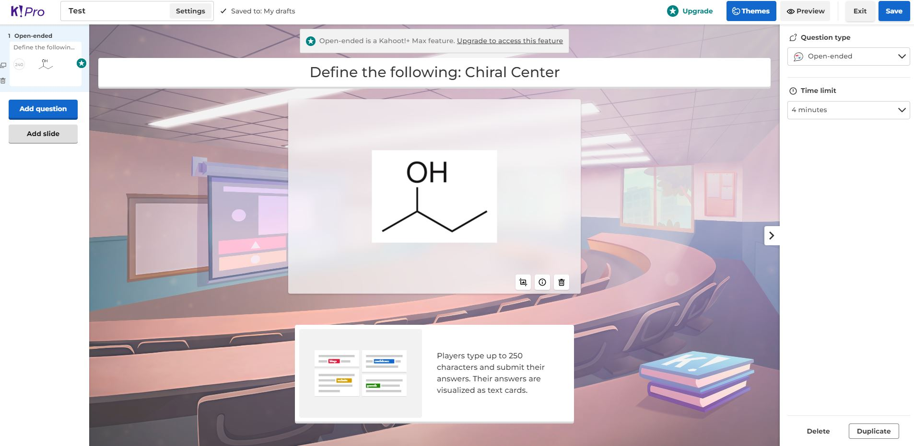
Stereochemistry - Round Table
Description of method:
At the beginning of class students would get into a group (maybe 10 min) and discuss a list of terms for the chapter. Based on a handout they will all have some input for the answers. A group leader will be designated and expected to present answers based on how I want to implement it.
Implementation plan:

Slide 44
Stereochemistry - Background Knowledge Probe
Description of method:
Background Knowledge Probe is a LAT used to collect feedback on students’ prior learning including knowledge critical to scaffolding, and misconceptions that may hinder learning.
In this LAT, the instructor prepares a short survey at the beginning of a course or before the start of a new unit or lesson. The instructor can use the collected data to fine-tune teaching strategies to better meet student needs.
Students complete the short survey prepared by the instructor, including articulating their level of confidence in the understanding of the material.
The Background Knowledge Probe can serve as a pretest and typically elicits more detailed information than other techniques. This information may include misconceptions, confidence, and knowledge of key concepts and terms. It can help address problems related to low motivation and insufficient class preparation because it helps instructors identify and tailor instruction to students’ needs.
However, this LAT may not be suitable for courses that emphasize integration, synthesis, and evaluation as it may not uncover incorrect or incomplete knowledge, attitudes, or values.
Implementation plan:
Learning objective: Identify the structural relationship between two molecules.
Background Knowledge Probe: Answer the following questions and rate your confidence in your answer from 1 (low) to 5 (high).
Define “isomer”. Confidence:
Distinguish between conformational, constitutional, and configurational isomers. Confidence:
Draw an example of configurational isomers. Confidence:
Tabulate:
the number of correct (+) and incorrect (-) answers
the corresponding confidence for each question
the number of incorrect responses having high confidence (>3)
the number of correct responses having low confidence (<3)
For each question, plot:
average number of correct answers
average confidence
number of incorrect answers having high confidence
number of correct answers having low confidence
These data may be used to identify starting points for instruction as well as likely misconceptions.

Slide 45
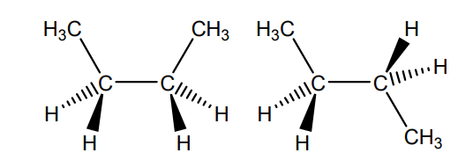
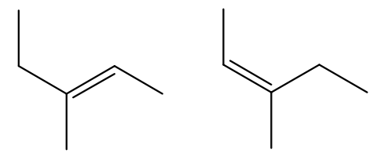
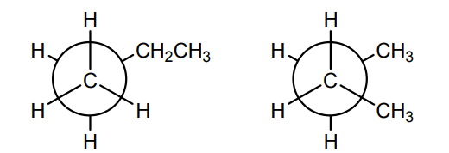
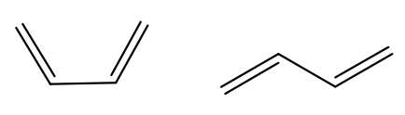
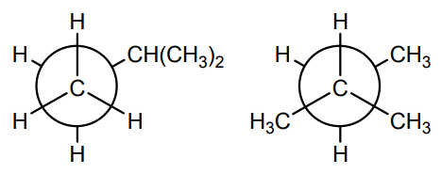
Stereochemistry - Background Knowledge Probe
Implementation plan:
Learning objective: Identify the structural relationship between two molecules.
Background Knowledge Probe: Answer the following questions and rate your confidence in your answer from 1 (low) to 5 (high).
Define “isomer”. Confidence:
Distinguish between conformational, constitutional, and configurational isomers. Confidence:
Place each molecule in the table. Confidence:
Draw an example of configurational isomers for any empty cells in the table above. Confidence:
 | Conformational | Constitutional | Configurational
Skeletal
Wedge-dash
Newman

Slide 46
Learning objective: Identify the structural relationship between two molecules.
What is the relationship between the molecules shown?
Conformational isomers
Constitutional isomers
Configurational isomers
Not isomers
.
.
3.
4.

Slide 47
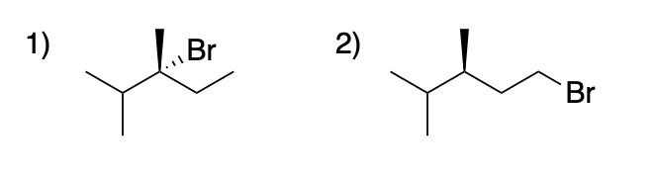
Stereochemistry - TAPPs
Description of method:
Think-Aloud Problem-Solving Process:
Student pairs receive a problem set designed by the instructor. One student acts as the “problem solver”, articulating the method he/she uses to solve a problem. The other student acts as the “listener”, carefully recording the steps taken by the problem solver to arrive at a solution. The pairs alternate roles as they work through the problem set. At the end of the exercise, both students verify the record of their own method and answers.
Analysis: The instructor marks each response as accurate/ inaccurate and reviews each individual’s problem-solving process marking accurate steps with a +1 and inaccurate steps with a –1.
Method Strength: This method allows the instructor (and students) to identify what specific step in a sequence of steps is resulting in a wrong answer. It helps students diagnose errors in logic and creates an awareness of successful and unsuccessful approaches to problem solving.
Potential Concern: Moderate-High prep/analysis time
Implementation plan:
Example Target Learning Objectives:
Use CIP rules to assign priorities for substituent groups
Assign absolute configuration to molecules having one chiral center
Provide an IUPAC name for a molecule with a chiral center
Example Problem:
Problem solver: Determine the IUPAC name for the first structure shown below. Carefully explain your method— step-by-step—as you solve the problem. Listener: Prepare a record of the problem solver’s step-by-step method for solving the first problem. Switch roles for the second problem.
Solution Steps:
Step 1 – identify parent chain name (pentane)
Step 2 – identify substituents (dimethyl; bromo)
Step 3 – locate substituents (2,3-dimethyl; 3-bromo)
Step 4 – identify chiral center (carbon 3)
Step 5 – assign priority of each adjacent atom (Br-1; C(Me)2-2; Et-3; Me-4)
Step 6 – assign R/S to chiral center (R)
Step 7 – write IUPAC name: (R)-3-bromo-2,3-dimethylpentane

Slide 48
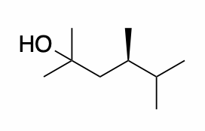
Stereochemistry - TAPPs
Instructions: Analyze the following molecule. Use the appropriate steps to assign the absolute configuration (R or S) at the chiral center. Explain the process you use to solve the problem step-by-step to the listener who should record these steps and ultimately record your final solution to the problem.
Expected Response:
    Identify the chiral center
    Draw in the implied hydrogen as a dash at the chiral center.
    Analyze the four atoms directly attached to the chiral center and prioritize them by atomic number. C C C (tied), H (priority 4).
    Label the tied carbon atoms as C_{A}, C_{B}, and C_{C} as a “bookkeeping” tool.
    Analyze the atoms bonded to the three carbon atoms that are tied. C_{A} (C, H, H), C_{B} (H, H, H), C_{C} (C, C, H).
    Based on the attached atoms, the three “tied” carbon can be prioritized as follows: C_{C} (priority 1), C_{A} (priority 2), C_{B} (priority 3).
    Rotate the molecule so that priority “4” is in the back. In this case it is already back so no further manipulation needs to be done.
    Draw a curved arrow from group 1 to 2 to 3.
    The curved arrow goes around clockwise making the assignment R-configuration.
Description of method:
Instructor
    Develop a set of problems
    Make a handout with the problems and a space for the listener to record responses
    Provide solutions to the problems with problem solving steps
    Incorporate extra problems or a challenge problem (for students who finish early)
    Analyze responses and note patterns.
    Address common misconceptions and deficiencies
Student
Students work in pairs solving the problems. One solves the problem by presenting a step-by-step problem solving process. The listener records the problem solving process and the result. They take turns in the two roles. Ultimately they should record one anothers responses to have a final Learning Artifact
Implementation plan:
Topic: Assigning R/S configuration at a chiral center
LO: Use CIP rules to assign priorities for substituent groups and assign absolute configuration to molecules having one chiral center

Slide 49
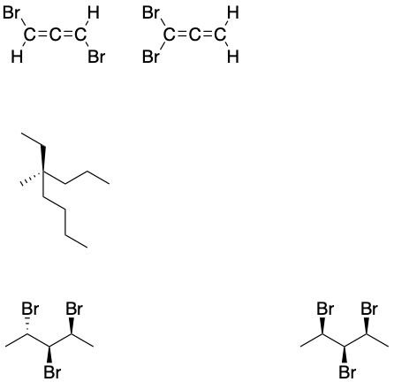
Stereochemistry - Knowledge Grid
Description of method:
Provide students with a grid that has specific column headings and row headings (these headings are concepts that you want them to explore - can be closely related, or not).
Students will then be presented with a specific prompt, and then fill in the grid based on the prompt. They can be provided with a list to choose from, or be asked to fill it in with their own ideas (open-ended).
Implementation plan: (Example)
Based on the list of molecules given below, fill in the grid appropriately.
 | Chiral | Achiral | Meso
Has 0 chiral centers
Has 1 chiral center
Has 2 or more chiral centers

Slide 50
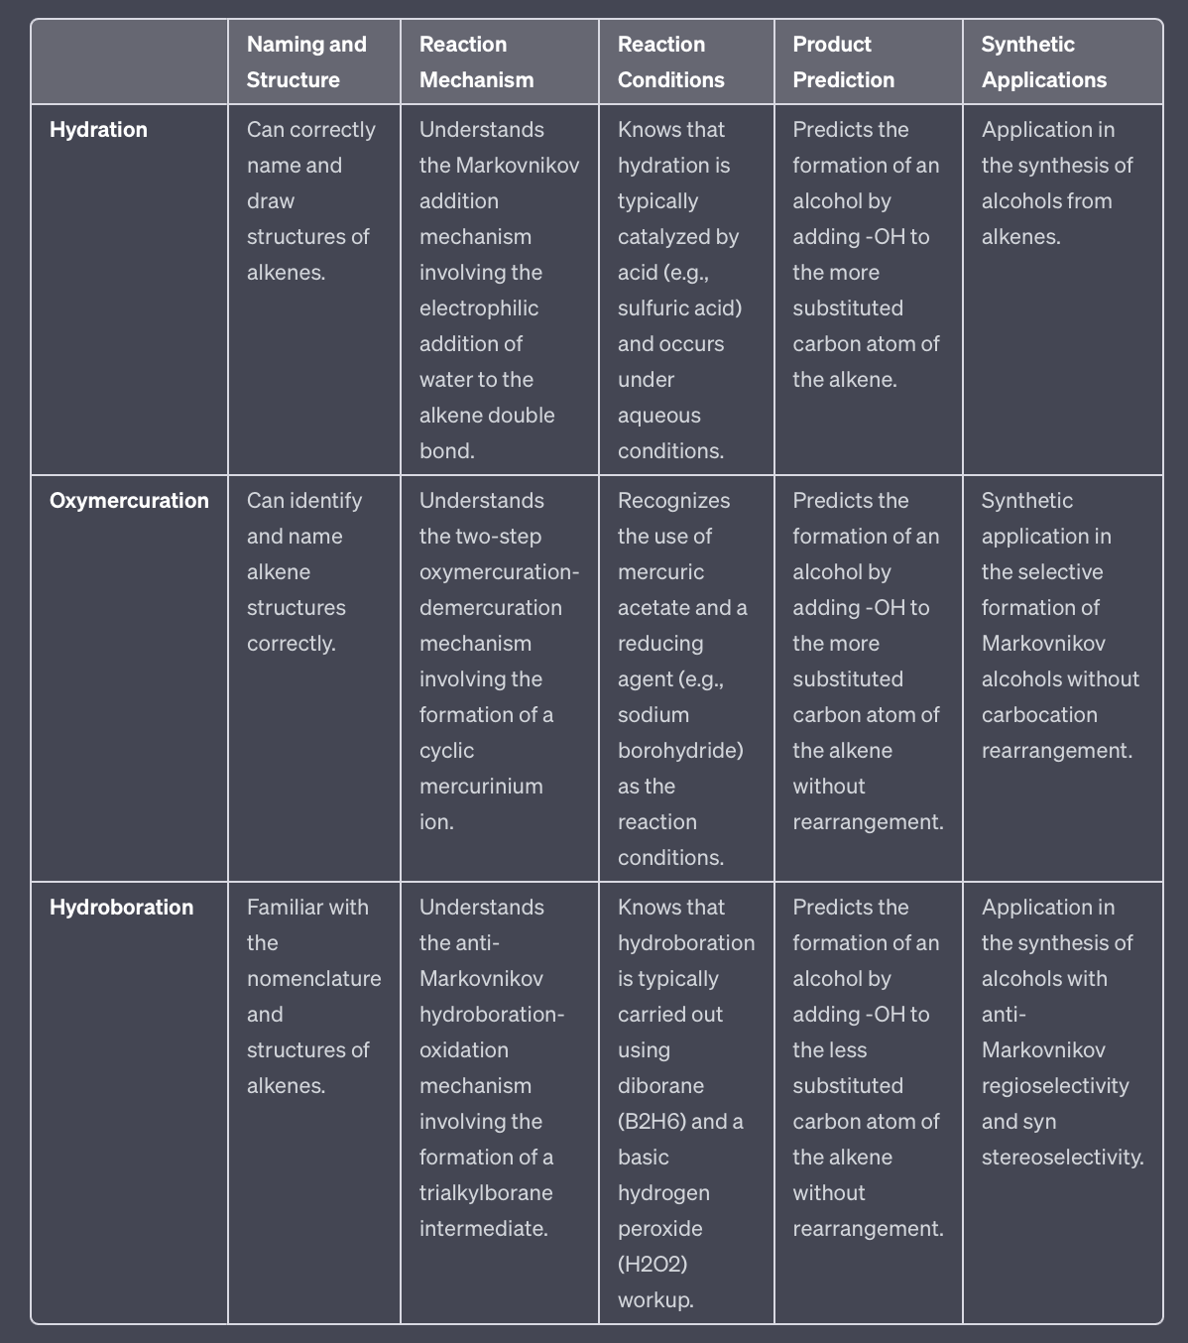
https://chat.openai.com/share/52fa4457-9a7a-4b43-8c5e-a3367b449b60

